Slide 1
Analysis of Descent Methods
Shreenidhi Sudhakar

Slide 2
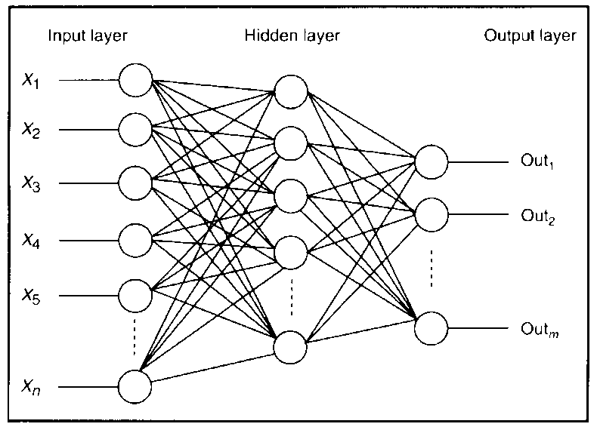
Architecture
Neural Network is implemented using Back Propagation algorithm
Gradients are updated sequentially from output to input layer. Hence, the name back propagation.
Advance models of Neural Networks are widely used in the market for image processing and language modelling

Slide 3
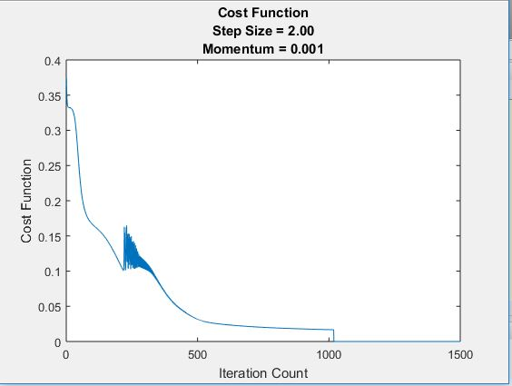
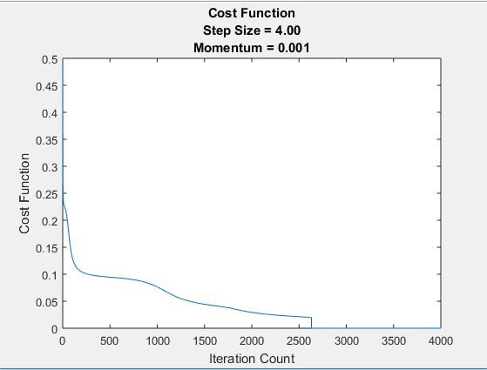
Results: Batch Gradient Descent
Iris
Car Evaluation

Slide 4
Results: Batch Gradient Descent
Iris Data Set
Learning Rate | Validation Set Accuracy | Test Set Accuracy | Training Converged | 3-Fold Cross Validation Error | Average Iteration Count
2 | 92.20 | 91.30 | False | 6.17 | 4000+
3 | 93.93 | 94.20 | True | 4.24 | 3831
4 | 94.51 | 94.20 | True | 4.72 | 2643
Car Evaluation Data Set
Learning Rate | Validation Set Accuracy | Test Set Accuracy | Training Converged | 3-Fold Cross Validation Error | Average Iteration Count
1 | 94.51 | 91.30 | True | 5.78 | 309
2 | 95.66 | 93.04 | True | 6.46 | 277
3 | 95.38 | 93.91 | True | 6.65 | 260

Slide 5
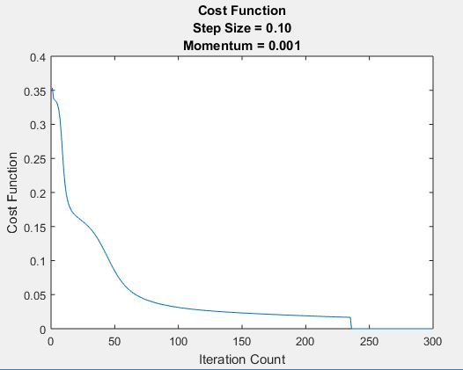
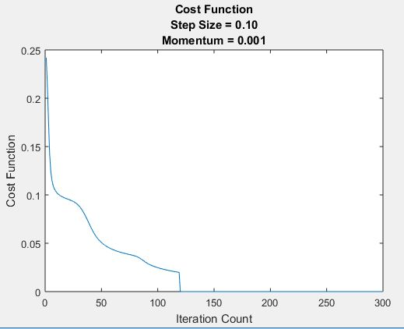
Results: Stochastic Gradient Descent
Iris
Car Evaluation

Slide 6
Results: Stochastic Gradient Descent
Iris Data Set
Learning Rate | Validation Set Accuracy | Test Set Accuracy | Training Converged | 3-Fold Cross Validation Error | Average Iteration Count
0.1 | 96.67 | 96.67 | True | 1.11 | 385
0.2 | 96.67 | 96.67 | True | 1.11 | 324
0.3 | 93.33 | 96.67 | True | 1.11 | 244
Car Evaluation Data Set
Learning Rate | Validation Set Accuracy | Test Set Accuracy | Training Converged | 3-Fold Cross Validation Error | Average Iteration Count
0.1 | 94.80 | 93.33 | True | 5.30 | 341
0.2 | 96.24 | 94.20 | True | 3.86 | 290
0.3 | 92.20 | 92.17 | True | 5.30 | 209

Slide 7
Real Time Applications
Self Driving Car
Video Analytics
Image Recognition

Slide 8
Thank You
Check Out: shreenidhi.azurewebsites.net

